Slide 1
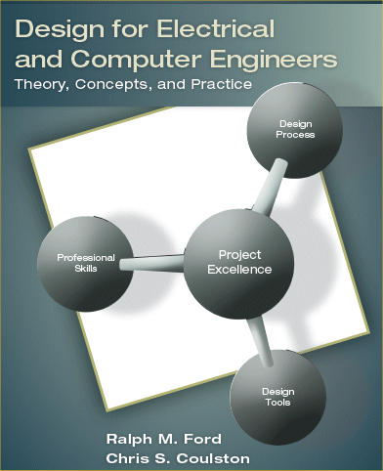
Chapter 6 – System Design II: Behavioral Models

Slide 2
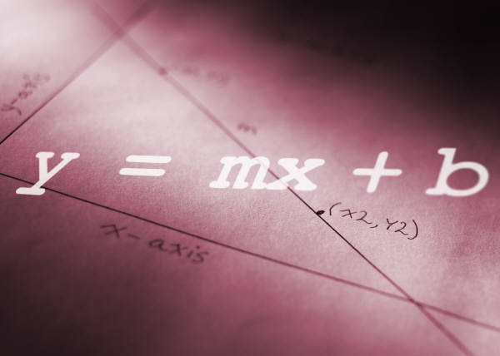
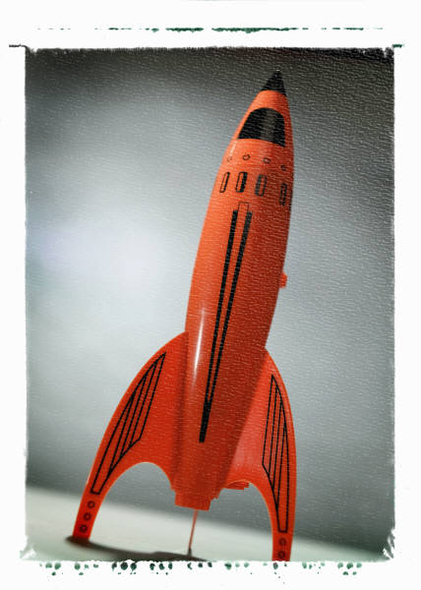
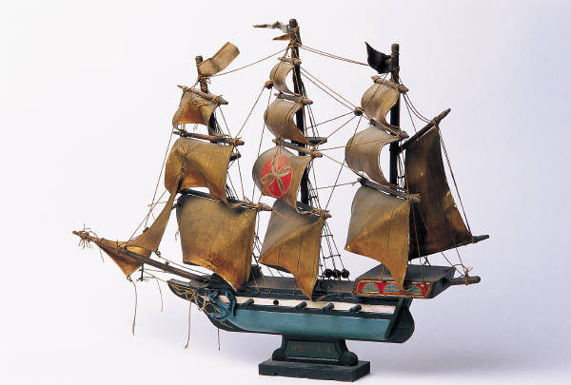
6.1 Models
Models - what do you think of?

Slide 3
A model behaves like (some part of) the intended system, but in a more convenient way.
A good model should be
Abstract
Unambiguous
Allow for innovation
Standardized
Facilitate good communication
Modifiable
Remove unnecessary details & show important features
Break system into sub-problems.
Substitute sequence of actions by a single action.
Assist in verification
Assist in validation

Slide 6
6.2 State Diagrams
Example: Vending Machine
Start Here
(also a state)
Steady
Discrete
“States”
Transitions
Just names of states. Should not have confused the issue
Inputs that
Cause
transitions
Where are the
outputs?

Slide 7
We’ll try doing it properly.
Moore Machine
Outputs on transitions
$0.00
Mealy Machine
Outputs for states

Slide 8
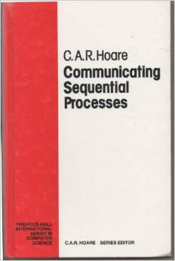
Does not have to be graphical
Refined to a science with
lots of theory
A lot like a programming
language.

Slide 9
Flowcharts
Symbols:

Slide 10
Example: Light Monitoring System
Can you figure out the operation of the system by looking at this?
That is why the flowchart is elegant and not so lowly. Hah!

Slide 11
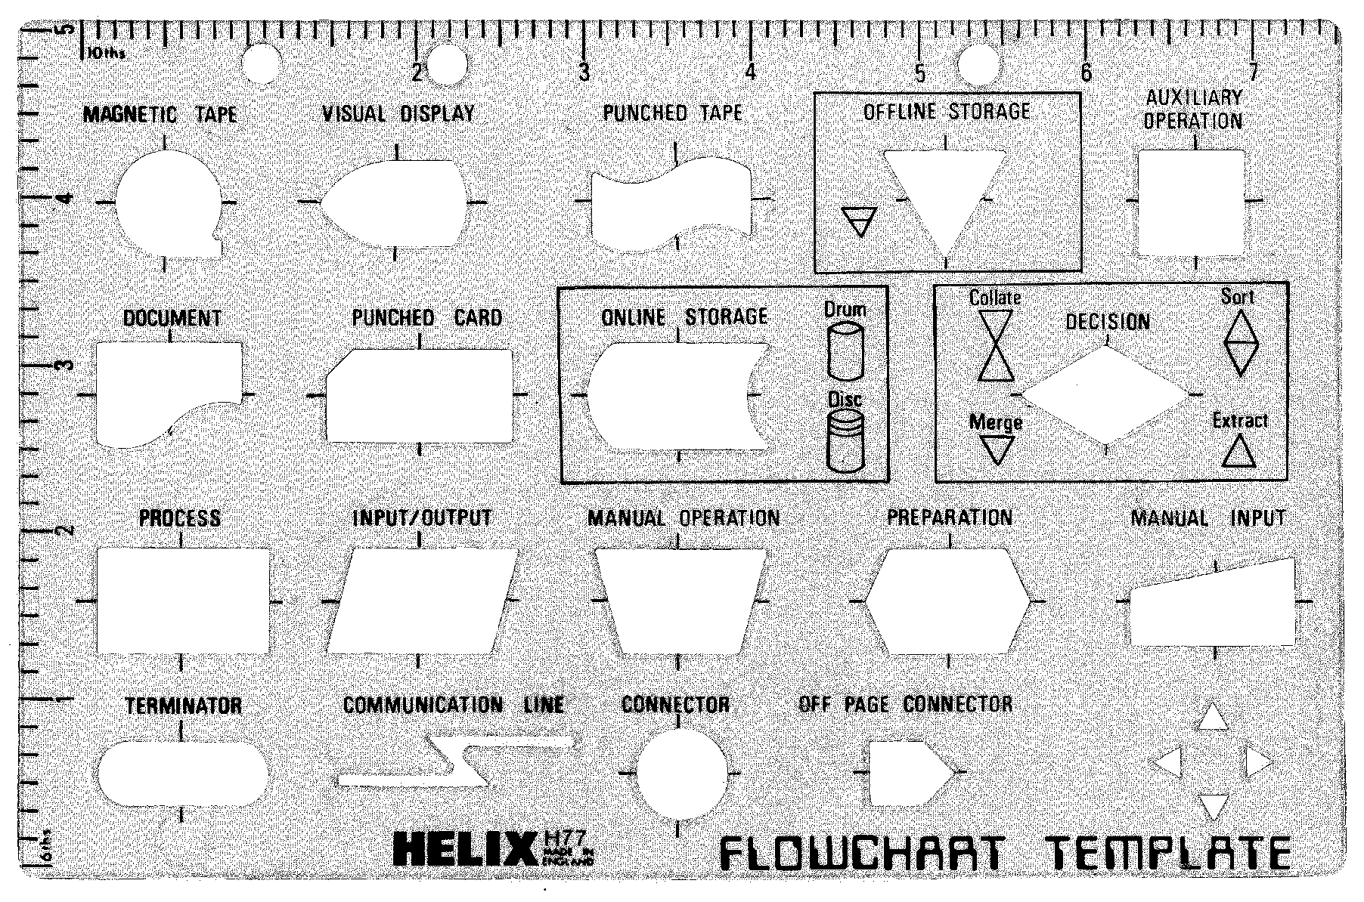

Slide 12
6.4 Data Flow Diagrams
Intention is ???
DFDs can have levels, just like the functional

Slide 13
Example: Video Browsing System

Slide 14
The Event Table
Event | Trigger | Process | Source
Annotate Video | New Video Arrival | Shot Boundary Detection | System
View Storyboard | Browse Request | Storyboard Preview | User
View Shot | Shot Preview Request | Shot Preview | User

Slide 15
6.5 Entity Relationship Diagrams
Intention of an ERD is
Entities =
Relationships =
Attributes =

Slide 16
Example: College Database System
To From | Student | Course | Department
Student |  | takes: one to many | major: 1 to ≥1
Course | has: one to many | pre-req for: one to any requires: one to any | offered by: one to one
Department | has majors: one to many | offers: one to many

Slide 17
College Database ERD

Slide 18
Try Again

Slide 19
UML - Scenario
Pretty popular idea – web ordering of groceries followed by home delivery.
The “v-Grocer” system.
User has a barcode scanner connected to home computer.
They can scan a used item an automatically order it from the grocery store.
Place the order and groceries delivered at pre-arranged time.

Slide 20
Static View
Object view of software.
Classes represent
  Data
  Methods (functions) that operate on the data
Objects are
Can allow for different security levels.

Slide 21
Class Diagram

Slide 23
Use-Case View
“Use-Case”
= activity
or procedure
Who’s involved in which activities
Intention =
Characterized by a Use-Case Diagram
Actors or Agents

Slide 24
Use-Case Description
Use-Case | WebOrder
Actors | Customer, Database, and WebServer
Description | This use-case occurs when a customer submits an order via the WebServer. If it is a new customer, the WebServer prompts them to establish an account and their customer information is stored in the Database as a new entry. If they are an existing customer, they have the opportunity to update their personal information.
Stimulus | Customer order via the GroceryCart.
Response | Verify payment, availability of order items, and if successful trigger the AssembleOrder use-case.

Slide 25
State Machine View

Slide 26
Activity View
Intention = describe a sequence of activities needed to complete a task.
This is really just a Petri Net used very badly.
Look up “Petri Net”.

Slide 27
Interaction View
Intention = to show interaction between objects (when they must cooperate to do something useful).
Use either a collaboration or sequence diagram.
This example is for the WebOrder use-case.

Slide 30
Physical View
Show the physical components that constitute the system.
Can think of this much more generally than presentation in UML.

Slide 31
6.8 Summary
Models are an abstraction of system.
Models can be thought of as a design specification.
Models have different intentions for describing behavior.
Models should encourage innovation and provide for clear documentation.

