Slide 1
Senior Project Proposal
Ed Lopez – VP, Carrier Solutions, Fortinet

Slide 2
Background
Notes:
Pricing
FortiGuard Services simple licensing and pricing model maintained
FortiGate more performance, more features, same aggressive pricing
No complex feature enablement
No per user calculations
No surprises

Slide 3
A Changing Landscape
Global IP traffic has increased fivefold over the past 5 years, and will increase threefold over the next 5 years
Globally, mobile data traffic will increase 11-fold between 2013 and 2018
Global mobile data traffic will grow three times faster than fixed IP traffic from 2013 to 2018
Productivity shift from corporate devices to BYOD is shifting data/application control to application servers and the network
Over half of all IP traffic will originate with non-PC devices by 2018
The number of devices connected to IP networks will be nearly twice as high as the global population by 2018
The emergence of cloud and data-center has radically redefined or even eliminated the network perimeter
Cybercrime is a growing cost to individuals and organizations alike
Network based security needs to evolve from a cost/compliance/liability model into a positive ROI model

Slide 4
Imminent Challenges
Moore’s Law is no longer keeping up with growth … inspecting application traffic at aggregation requires multiple processor solutions
Network security appliances require network traffic to be directed to them for inspection, but this now needs to be performed at cloud/data-center aggregation points
Video traffic now represents the majority of traffic, eclipsing web traffic (which previously eclipsed email traffic) … network security must evolve to consider changing IMIXs and business models
Ex.: Need to inspect data in depth, while only controlling access and forwarding of voice/video
Virtualization of network assets is a massive orchestration challenge

Slide 5
Performance Challenge – Security Needs To Keep Up With Bandwidth Requirements
1,000,000,000
1 Terabit
100,000
100 Gigabit
Core Networking Doubling ~18 mos
10,000
10 Gigabit
Rate Mb/s
1,000
Gigabit
Server I/O Doubling ~24 mos
100
1995
2000
2005
2010
2015
2020
Source : IEEE 802.3 Industry Connections Ethernet Bandwidth Assessment July 2012
Notes:
“The Performance Challenge – Security Needs to Keep Up with Bandwidth Requirements
Network bandwidth requirements are doubling every 18months, thanks to rapid growth in connected devices, big data, virtualization, cloud storage and SaaS applications
Network security solutions that cannot keep up will quickly become a choke point and slow down critical business traffic
(This slide/point is addressed by FortiASIC advantage on a later slide)

Slide 6
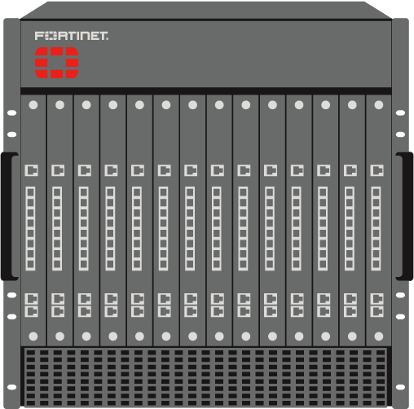
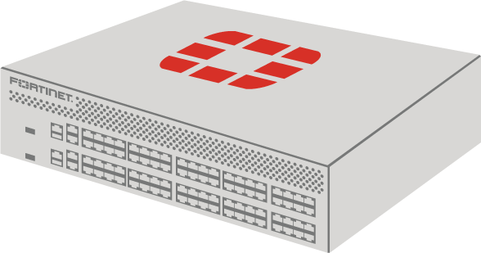
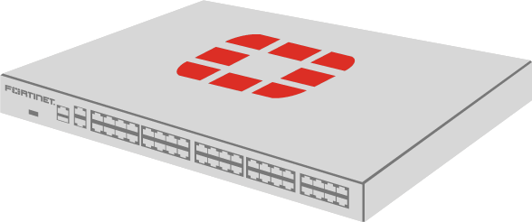
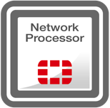
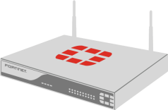
1st Generation Security – Scalable Appliances
Performance & Scalability
 | Entry Level | Mid Level | High End
FortiGuard
FortiOS
FortiGate 30 – 90
(Access)
FortiGate 100 – 800
(Edge NGFW)
FortiGate 1000 – 5000
(Edge NGFW or Core DC)
Notes:
The FortiGate platform is extremely scalable from a Entry Level SMB to Mid Level to High end
Entry Level FortiGates (30 to 90 series) range from 800Mbps to 3.5Gbps of Firewall throughput and from 150Mbps to 275Mbps of NGFW throughput
Mid Level FortiGates (100 to 800 series) range from 2.5G to 20G of Firewall throughput and from 950Mbps to 6G of NGFW throughput
High End FortiGates (1000 to 3000 series) range from 20G to 160G of Firewall throughput and from 5G to 20G of NGFW throughput
The FGT 5000 series chassis-based models extend all the way up to 1 Terabit per second of FW throughput
FortiOS is common across all FortiGate Models
FortiGuard Security updates are also available to all models

Slide 7
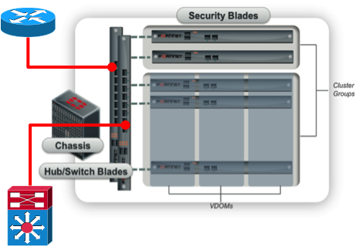
2nd Generation Scalability - Clustering
Using a combination of load-balancing combined with data normalization, develop multi-device solutions that act as a single inline device
Stateless or session aware load-balancing
Data normalization of routing tables, ARP tables, device configuration, authentication states, etc.
Performed in chassis or via the use of external load-balancers
Cluster size limits, based on number of devices, chassis size, number of ports, etc.

Slide 8
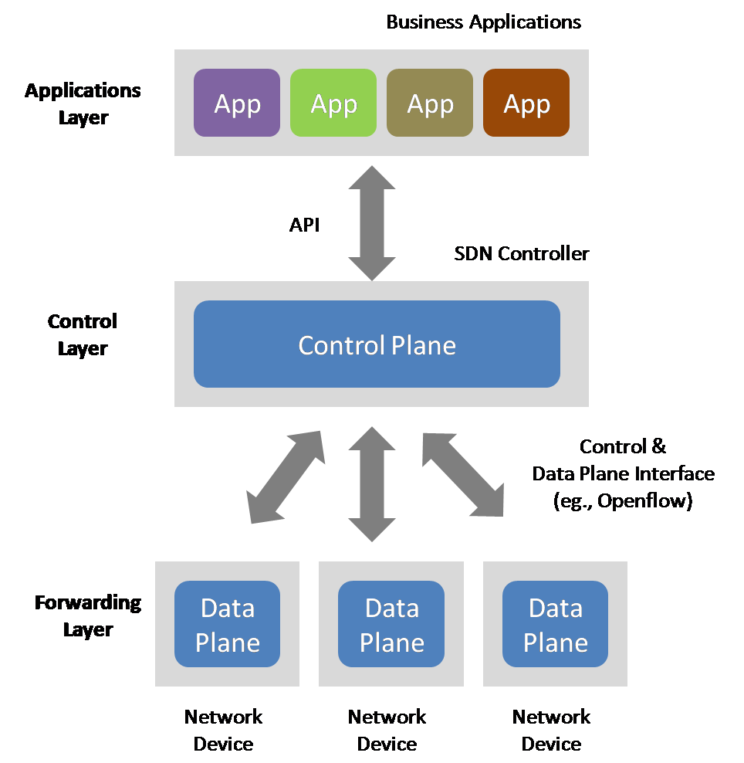
3rd Generation Scalability – SDN & NFV
Network Function Virtualization is the ability to provide virtualized network services within hypervisor-based environments
Fortinet provides an array of VM-based products that integrate into NFV environments
Software-Defined Networking is a way to describe abstracting network functions in order to virtualize or control by software. This is done by decoupling the operating system (software) that makes decisions about where network traffic is sent from the underlying hardware that forwards traffic to the selected destinations
Use of SDN flow-programmable devices to shunt traffic of interest to an array of security and monitoring appliances
“Security Without Limits”, as performance limits are shifted from in-line security devices to line-rate performance of the network architecture

Slide 9
FortiCore
Providing ‘Security Without Limits’, FortiCore is an SDN flow programmable appliance which can distribute traffic of interest across an array of network security and monitoring appliances, while maintaining line-rate performance on a high-speed network link
Link-based vs. node-based – security/monitoring where its needed (network instrumentation)
Only shunts traffic of interest, while maintaining high bandwidth, low-latency performance on 40G/100G links
Two FortiCore Models – Shipping 1H’2015
FortiCore 6100A – Two 100G Interfaces, twenty-four 10G interfaces
FortiCore 6040A – Two 40G interfaces, forty-eight 10G interfaces

Slide 10
FortiCore 6100A Block Diagram
AC Supply
Gfd wqaq
STORAGE X2
RAM
Flash
PSU
PSU
8 Core CPU
PCI-E Switch
FPGA Switch Fabric
Quad Core
CPU
FPGA MultiTable
Pipeline
FPGA MultiTable
Pipeline
FPGA MultiTable
Pipeline
FPGA MultiTable
Pipeline
USB
RS-232
1G
1G
100G
SFP+
100G
SFP+
SFP+
SFP+
SFP+
SFP+
SFP+
SFP+
SFP+
SFP+
SFP+
SFP+
SFP+
SFP+
SFP+
SFP+
SFP+
SFP+
SFP+
SFP+
SFP+
SFP+
SFP+
SFP+
Notes:
10

Slide 11
FortiCore OS
Linux 3.14 kernel
Support for Kernel Virtual Machine (KVM) hypervisor environment
Will run a FortiSphere micro SDN controller as a virtual machine, to allow local programming of flows
Support for OpenFlow 1.3.4
OpenFlow standard is maintained is by the Open Networking Foundation (ONF)
https://www.opennetworking.org/images/stories/downloads/sdn-resources/onf-specifications/openflow/openflow-switch-v1.3.4.pdf
Open vSwitch (OVS) is used as an OpenFlow agent, operating as an abstraction layer to program the FPGA switching matrix and pipelines via OpenFlow statements
Configuration is managed via FortiOS shell CLI and GUI

Slide 12
FortiCore – Link Transection (TRANSECT)
FortiCore
The FortiCore is inserted in a transected link between existing active components
Traffic-of-interest is shunted to the FortiDevices associated with the FortiCore
Other traffic is forwarded through – maximizing transparency relative to the link traffic
Link-based provides an ‘network instrumentation’ model
Can also replace existing (underperforming) in-line network security appliances

Slide 13
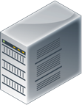
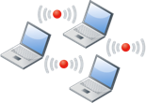
FortiCore – Differential Routing (DIFFROUTE)
DATA CENTER
ENTERPRISE
FortiEdge
FortiCore
CGN
FortiEdge
Traffic Encapsulation & Differential Routing
Application-Based Forwarding
FortiCore
Traffic Encapsulation Aggregation
Programable Forwarding Through Security Devices
CGN
Enforces Session Integrity
Internet Routing

Slide 14
The Project
Notes:
Pricing
FortiGuard Services simple licensing and pricing model maintained
FortiGate more performance, more features, same aggressive pricing
No complex feature enablement
No per user calculations
No surprises

Slide 15
What Is Orchestration?
Superflow – A policy statement representing a bi-directional traffic flow
Relative to SDN, a superflow can be broken down into individual uni-directional flow statements
In the case of traffic-of-interest flowing through a FortiCore, a superflow breaks down into four individual flows:
Organization -> FortiDevice
FortiDevice -> Target
Target -> FortiDevice
FortiDevice -> Organization
Orchestration is an tool that intelligently converts operational constructs (in this case policies/superflows) into control elements (in this case OpenFlow statements)
Target
FortiDevice
FortiCore
Organization

Slide 16
What Is An Organization?
An organization represents a set of IP endpoints, such that traffic to/from the organization is subject to inspection
Relative to FortiCore, an organization can be:
Traffic which exists on an identifying VLAN on a transected link
Only on a single VLAN tag, otherwise VLAN tag value is ignored
A contiguous IP subnet (address/mask), including a single host
Both of the above
An organization is represented by a discrete set of OpenFlow flow match structures
IN_PORT
VLAN_VID
IPV4_SRC/IPV6_SRC or IPV4_DST/IPV6_DST
Depending on if the organization is the source or destination of the originating traffic flows in an IP session
It is important to note that opposite structures are used for reply traffic flows in an IP session
An organization is also represented by a similar set of discrete OpenFlow action structures
OUTPUT
PUSH_VLAN/POP_VLAN

Slide 17
What Is A FortiDevice?
A FortiDevice is a network security device that can be associated with an organization’s traffic
A FortiDevice can be defined by OpenFlow flow match structures, if the security functions of that FortiDevice can be defined by a Layer 4 filter (IP protocol/port)
Ex.: A web application firewall such as FortiWeb would be interested in TCP/80 and TCP/443 traffic by default
IN_PORT, VLAN_VID, IP_PROTO & TCP_DST/UDP_DST/SCTP_DST/ICMP_TYPE, when evaluating originating traffic
IN_PORT, VLAN_VID, IP_PROTO & TCP_SRC/UDP_SRC/SCTP_SRC/ICMP_TYPE, when evaluating reply traffic
In any case, a FortiDevice can be defined as a set of OpenFlow action structures
OUTPUT
VLAN_VID

Slide 18
What Is A Target?
The real purpose of the FortiCore device is to direct traffic-of-interest to/from an organization, through the appropriate FortiDevice for inspection
Therefore a target is has a relatively vague definition
IN_PORT & VLAN_VID within OpenFlow flow match structures
OUTPUT & PUSH_VLAN/POP_VLAN within action structures
There is a need for vagueness here, due to the ‘best-match/first-match dilemma’, associated with integrating stateless forwarders and stateful inspectors within a common networking solutions
Stateless forwarders such as routers and switches, including SDN switches, make forwarding decisions based on best-match parameters
Such as ‘exact-match’ or ‘longest-prefix match’
Stateful inspectors such as firewalls make forwarding decisions based on first-match parameters
Better said that first-match parameters supercede best-match parameters
A firewall policy table is a good example
To resolve this, it is important to segregate forwarding responsibility between FortiCore and FortiDevices
FortiCore is responsible to forward an organization’s traffic to/from its appropriate FortiDevice
FortiDevices are responsibility to filter and forward traffic based on opganization<>target policies

Slide 19
The Need For Orchestration Tools
As FortiCore forwards traffic based on individual programmed flows, actually manually programming these flows would be a gargantuan task
If a FortiCore supported 2,000 organizations, and each organization used up to four FortiDevices, this would represent 8,000 superflows to represent all of these associations
With each superflow representing 4 flows, this represents 32,000 programmed flows
What is needed is an orchestration solution to aid administrators in simplifying the task of generating the required number of programmed flows

Slide 20
Project – Build An Orchestration Engine For FortiCore
The solution must be open-source, or based on open-source tools
No commercial tools are allowed to be used
The resulting orchestration engine must remain open-sourced
It must be delivered in the form of a virtual machine that can run on KVM
It must incorporate an SDN controller that can support OpenFlow 1.3+
You have the freedom to choose any available open-source SDN controller, or build your own
NTT’s RYU controller is a favorite, and requires knowledge of Python
It must have a database in support of definable objects, as well as storage of the programmed flows
It must have a GUI for use in configuring the orchestration engine itself, as well as for inputting the required superflows
Administrative ease-of-use will be a major factor in grading the project

Slide 21
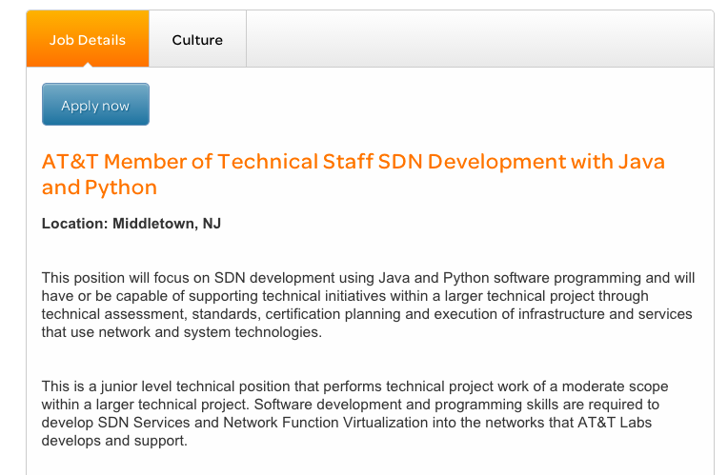
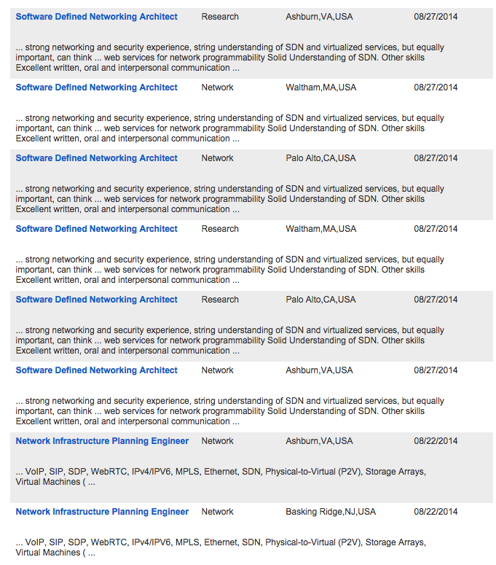
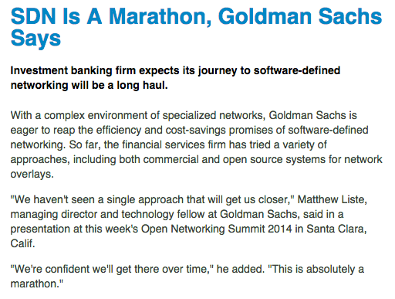
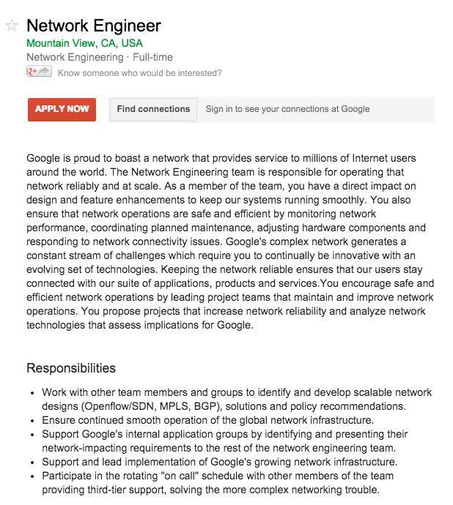
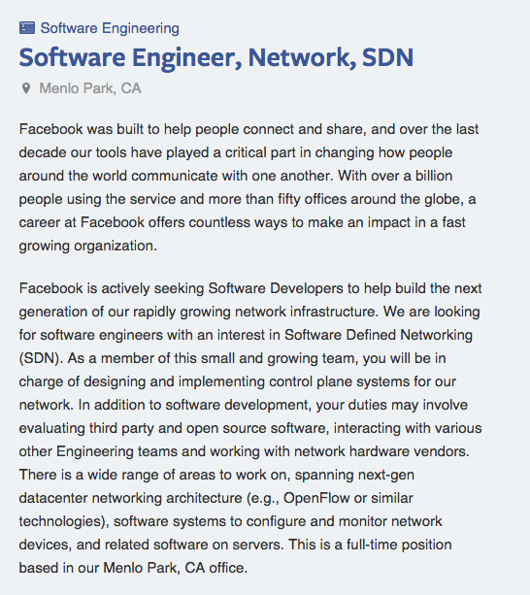
SDN Opportunities Abound!

